Slide 1
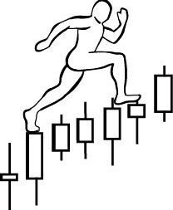
HOMEWORK
due on April 8
Situation:
4 charts are exhibited in each slide. One of them is S&P500 at the important swing top or bottom. The next swing is an opposite swing to the current swing. So, you are given a directional bias for the next swing.
Task:
Chose a stock (or stocks) at the market top that has the following characteristics:
1. A stock is in the distribution/redistribution range
2. A stock is either in Phase C, D or E
3. A stock that has the most potential to advance down on the next down swing
Chose the chart(s) at the market bottom that has the following characteristics:
1. A stock is in the accumulation/re accumulation range
2. A stock is either in Phase C, D or E
3. A stock that has the most potential to outperform on the next up swing
Goal:
To practice identifying a stock that is stronger before upswing or weaker before downswing and that is ready to advance after the market reversal.
www.WyckoffAnalytics.com Copyright © 2019 Wyckoff Associates, LLC. All Rights Reserved.

Slide 2
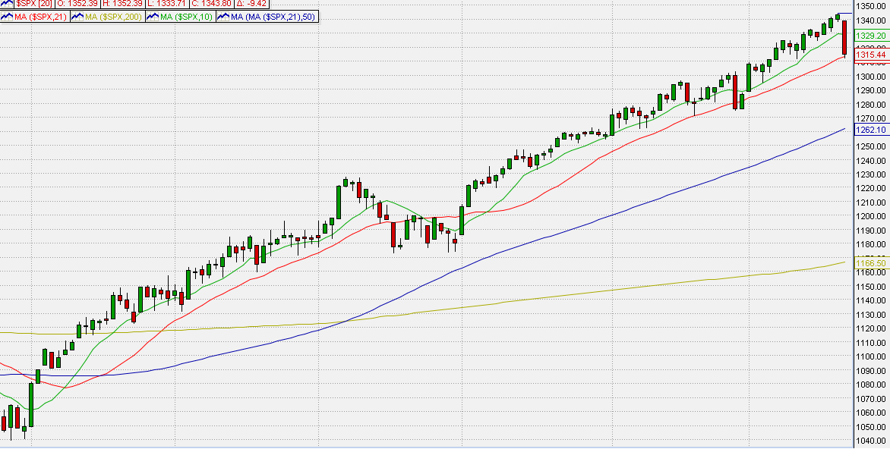
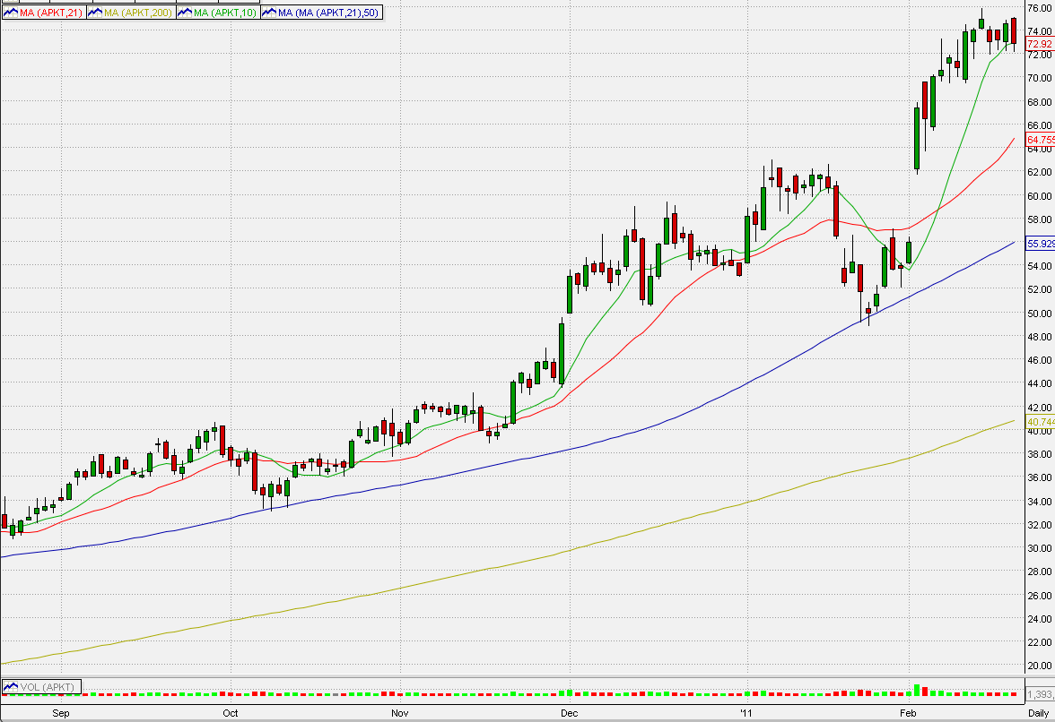
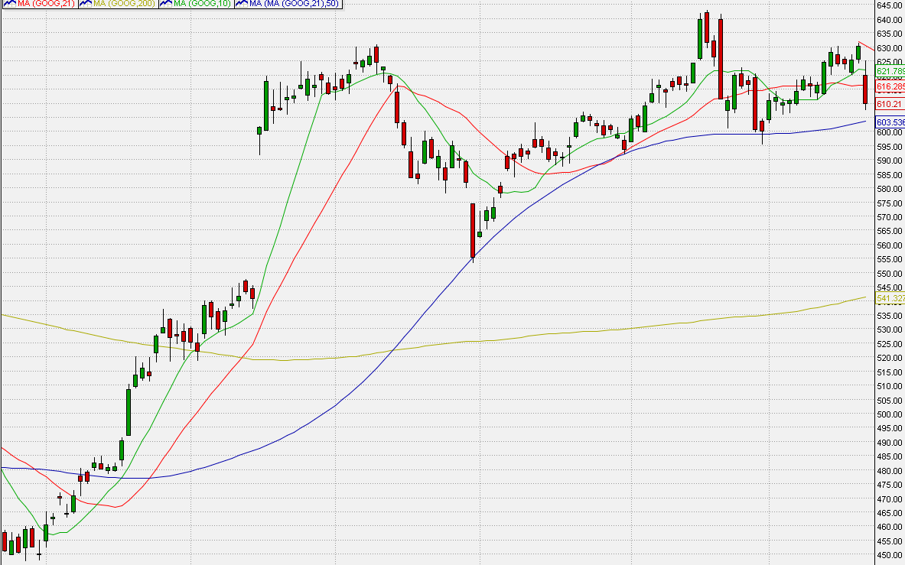
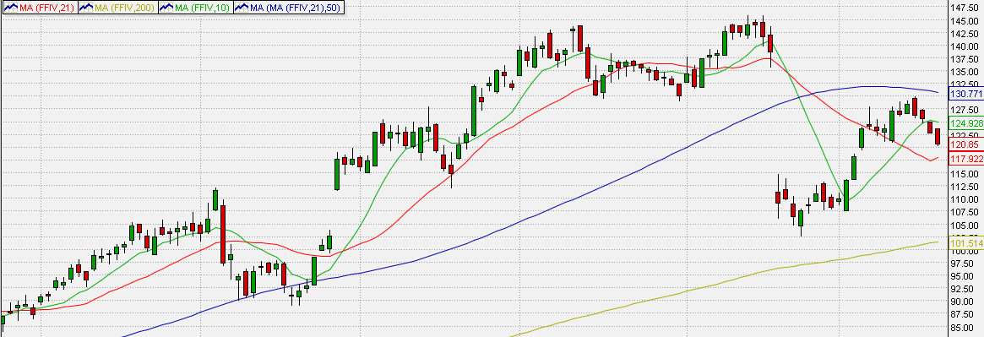
Market Bias = Down
S&P500 - 2/18 market top
Stock #1
Stock #2
Stock #3
www.WyckoffAnalytics.com Copyright © 2019 Wyckoff Associates, LLC. All Rights Reserved.

Slide 3
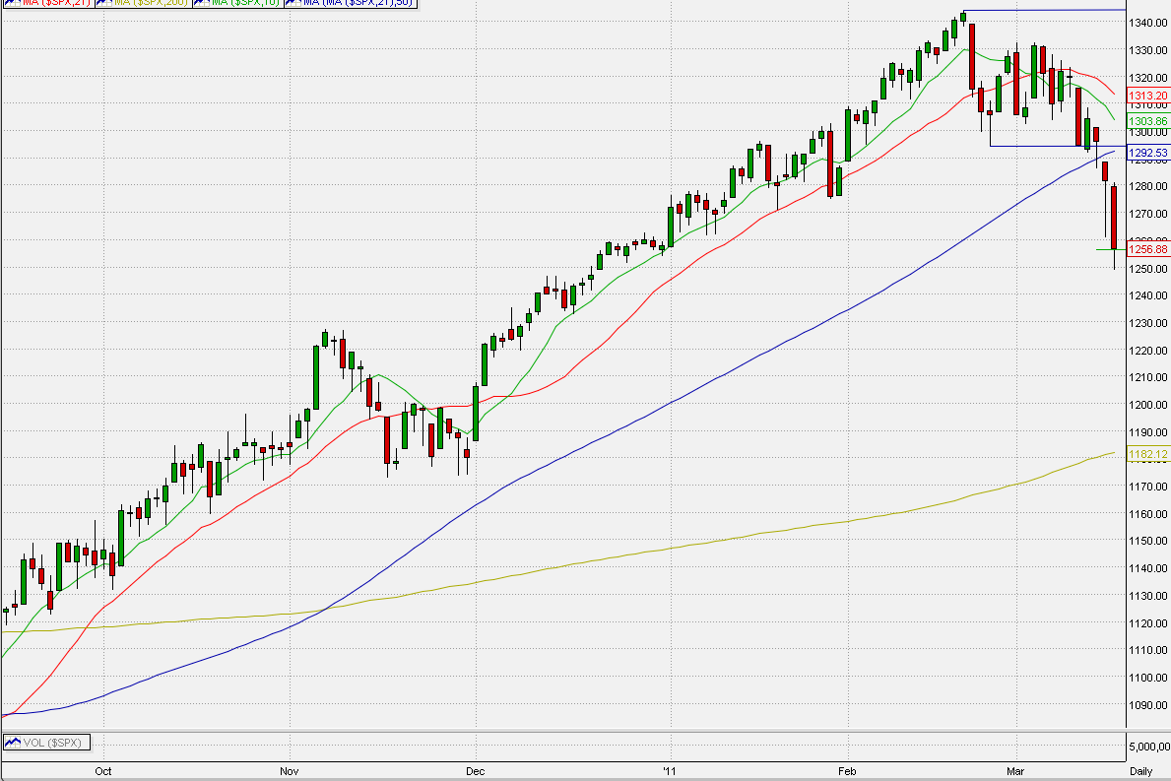
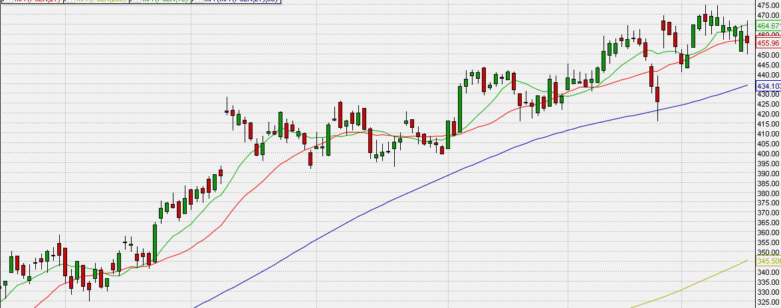
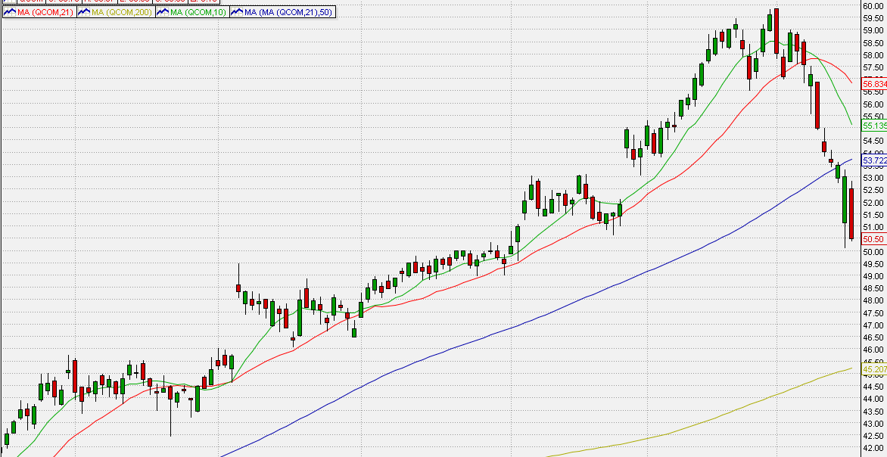
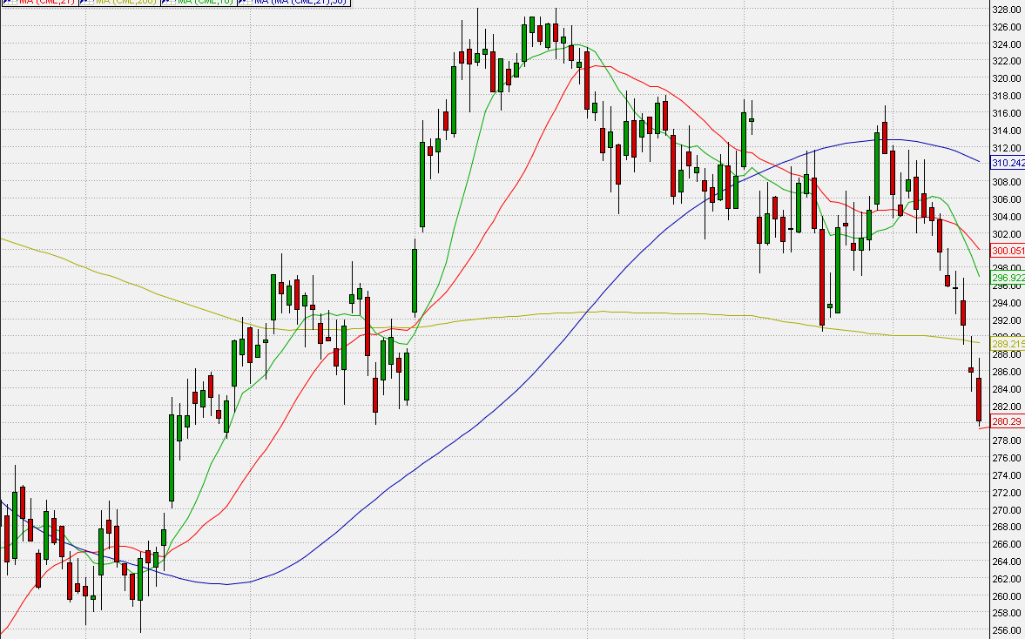
Market Bias = Up
Stock #1
S&P500 - 3/16 market bottom
Stock #2
Stock #3
www.WyckoffAnalytics.com Copyright © 2019 Wyckoff Associates, LLC. All Rights Reserved.

Slide 4
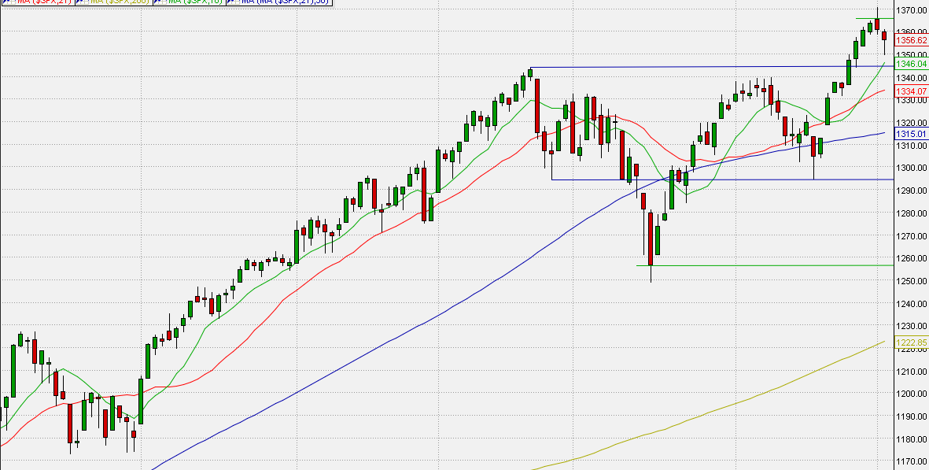
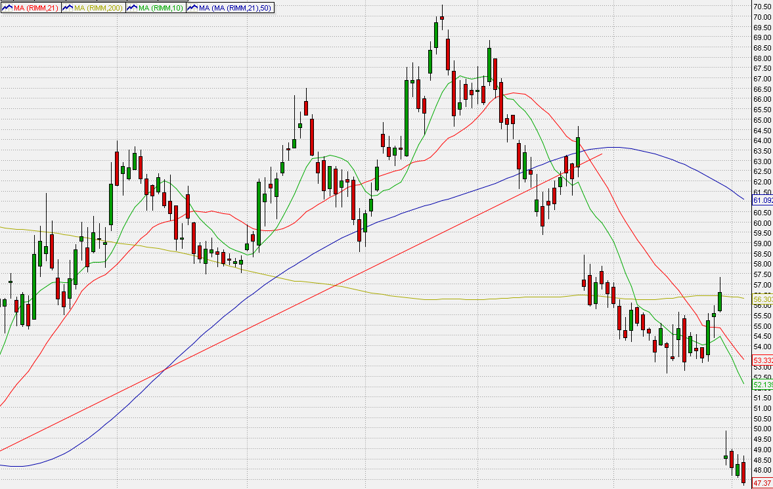
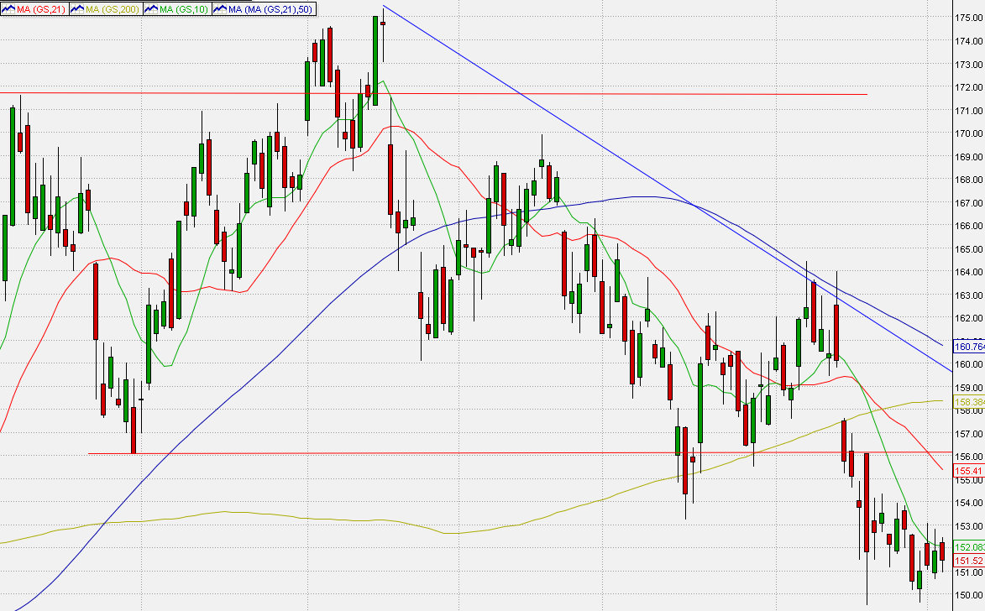
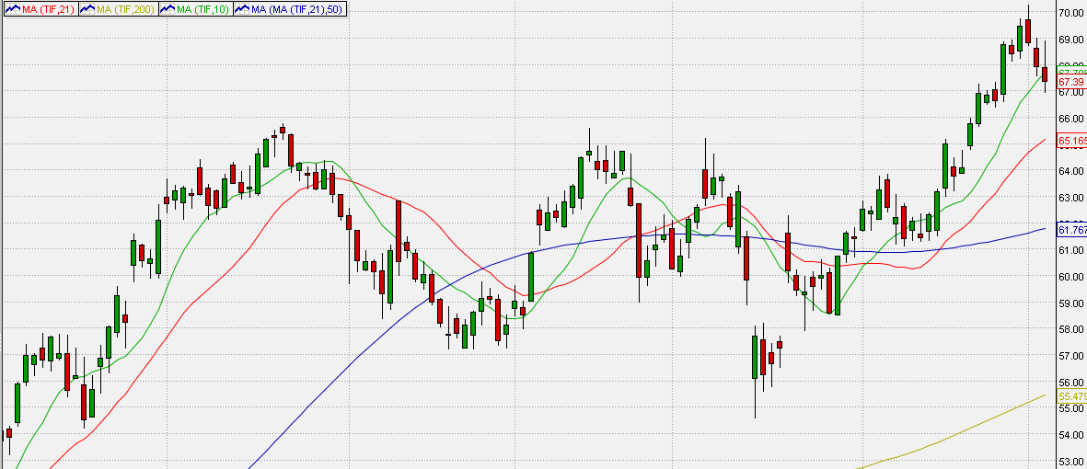
S&P500 – 5/02 market top
Market Bias = Down
Stock #1
Stock #2
Stock #3
www.WyckoffAnalytics.com Copyright © 2019 Wyckoff Associates, LLC. All Rights Reserved.

Slide 5
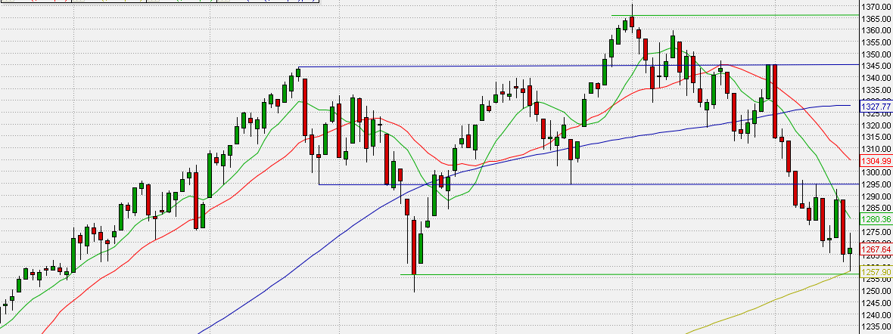
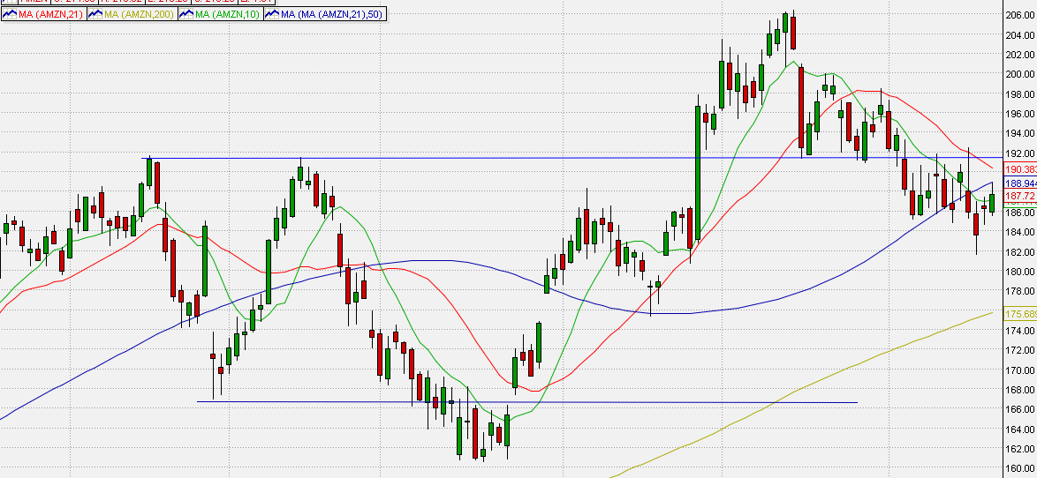
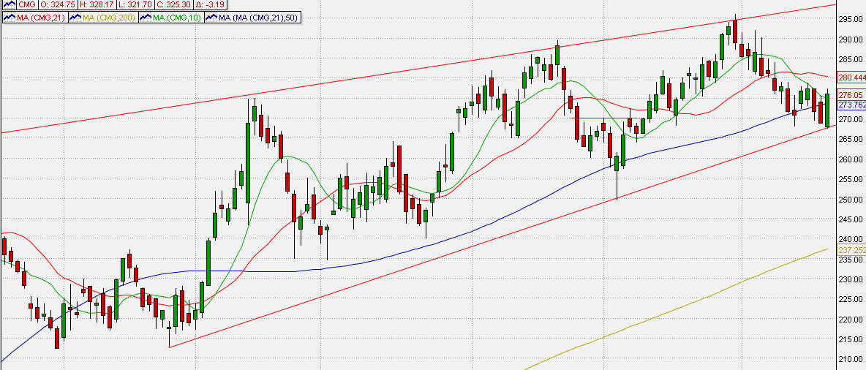
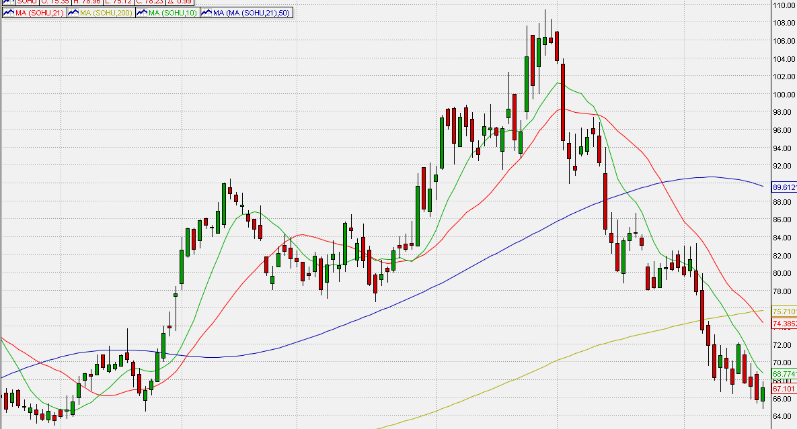
Market Bias = Up
Stock #1
S&P500 - 3/16 market bottom
Stock #2
Stock #3
www.WyckoffAnalytics.com Copyright © 2019 Wyckoff Associates, LLC. All Rights Reserved.

